Slide 1
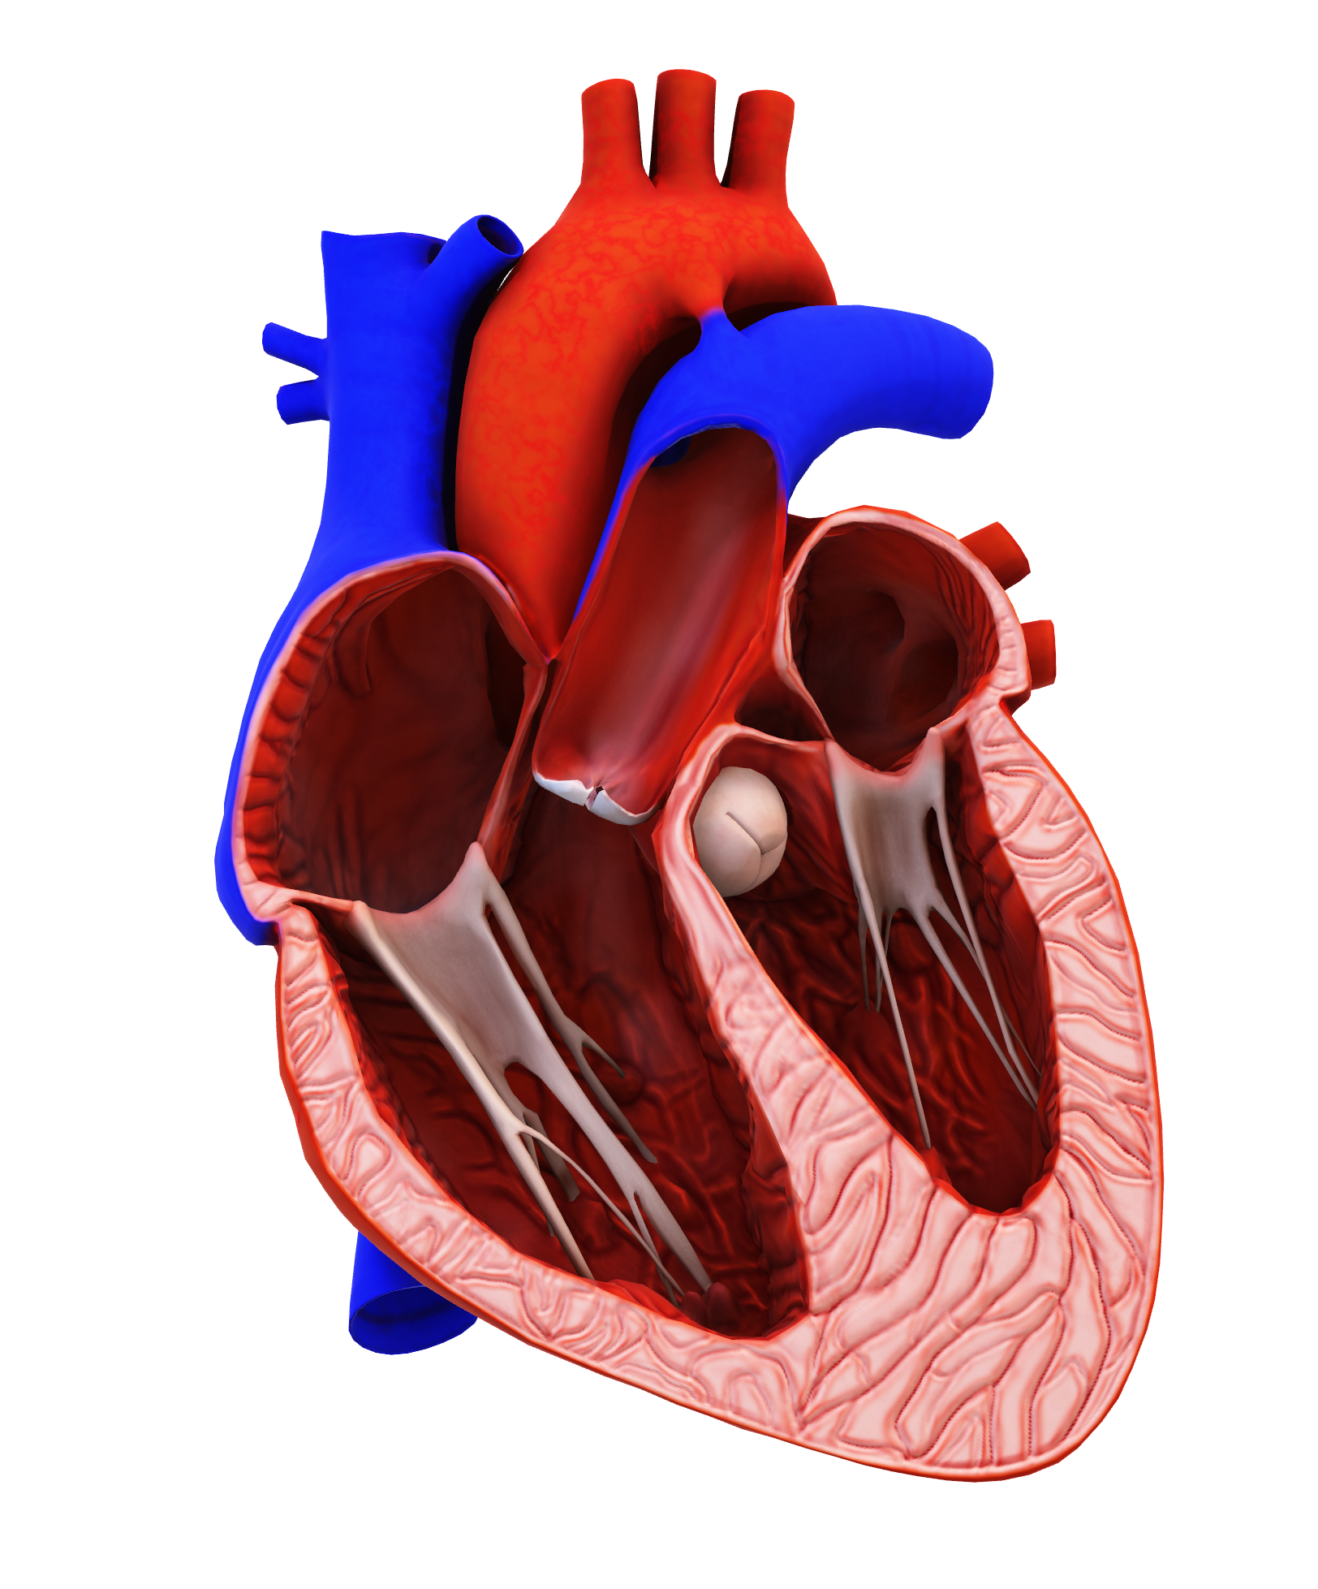
HEART DISEASE
HEART DISEASE
HEART DISEASE

Slide 2
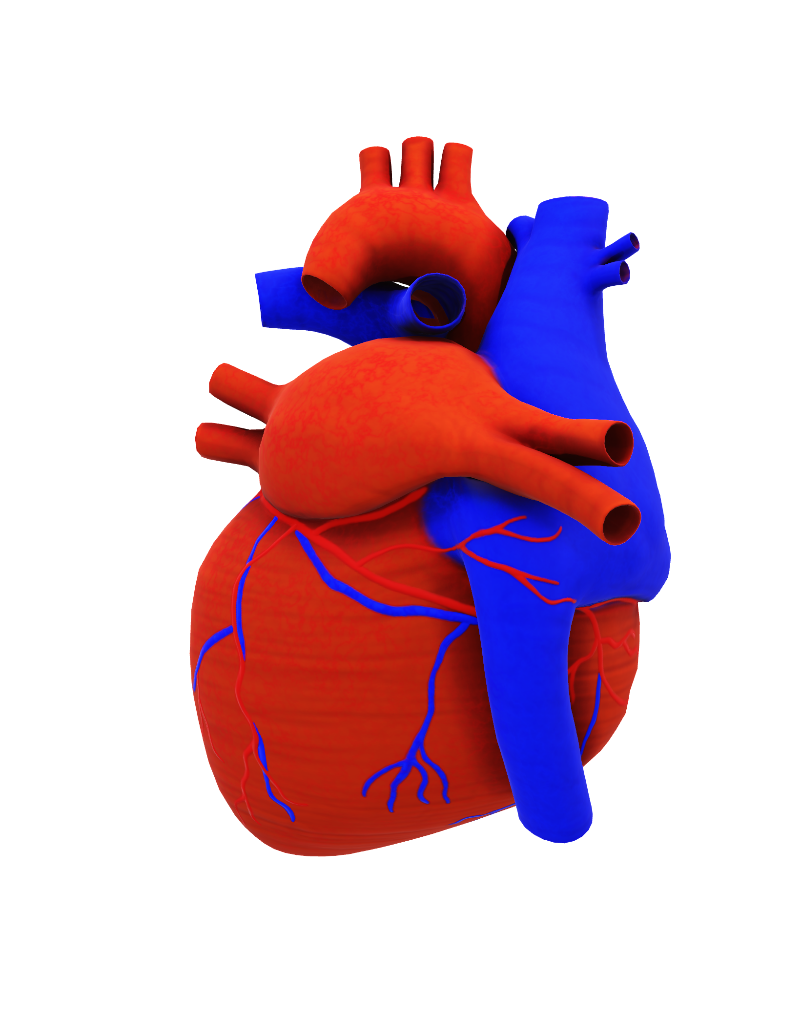
HEART DISEASE
HEART DISEASE
HEART DISEASE

Slide 3
Research Questions
Ange
What age group is heart disease most prevalent?
Does the amount of sleep that someone gets correlate with the presence of heart disease?
Are people with higher BMI more likely to have heart disease?
Which lifestyle choice correlates higher with the presence of heart disease? Smoking or drinking alcohol?

Slide 4




OVERVIEW OF HEART DISEASE
Ange
Heart disease is classified by many heart-related conditions such as coronary heart disease, heart attack, arrythmia, and heart failure
Heart disease is the #1 cause of death in the U.S.
In 2021, 1 in every 5 deaths was caused by heart disease
Risk factors such as diabetes, obesity, lack of physical activity, and unhealthy diet can increase the likelihood for heart disease
Electing to have healthy habits and strongly regulating other preexisting medical conditions can help lower the risk of heart disease
Source: CDC

Slide 5
DATA BACKGROUND
Oluwaseun
OUR DATA
Landline and cellphone-based survey following a questionnaire created by the CDC (Centers for Disease Control and Prevention) and BRFSS (Behavioral Risk Factor Surveillance System)
Data collected from across the United States with each state having the ability to include modules for specific topics
319,975 participants in the self-reported survey
Of those, 27,373 reported having heart disease

Slide 6
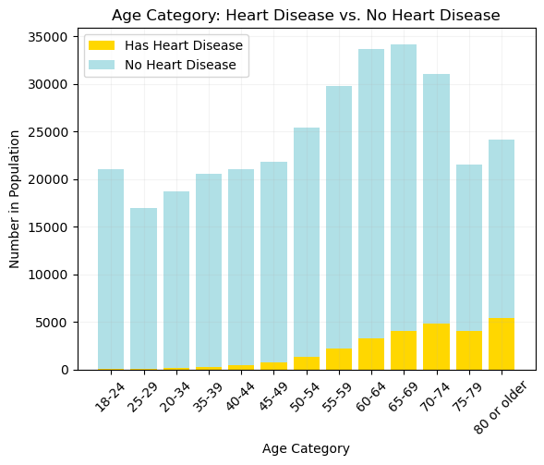
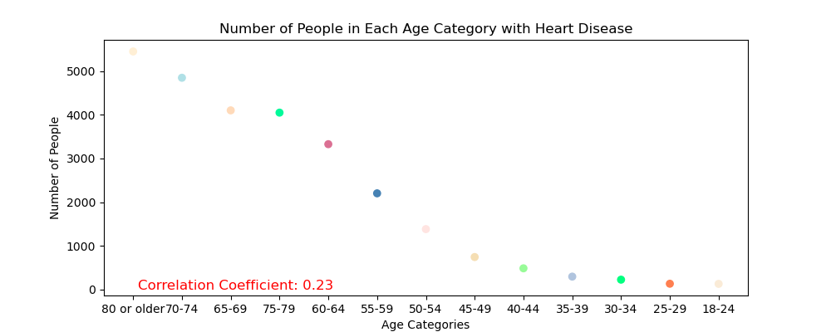
DEMOGRAPHICS: AGE
Oluwaseun
We predicted that as the age group increases the pervasiveness of heart disease would also increase
Looking at the charts, our prediction would appear to be correct
However, the correlation coefficient shows a statistically low correlation
Heart disease gradually increases in prevalence with each age category with one exception in the 75-79 age category

Slide 7
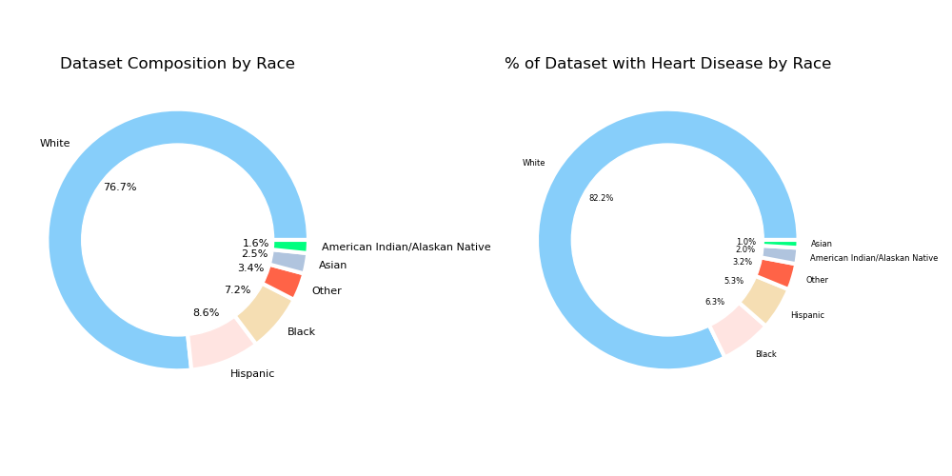
DEMOGRAPHICS: RACE
Aaron
White people composed over ¾ of the total dataset
4 out of every 5 people with heart disease from our dataset, taken at random, would be White
White and Native American were the only races to have a larger portion of the ”having heart disease” pie than their respective populations in the dataset, meaning heart disease is more prevalent among these races

Slide 8
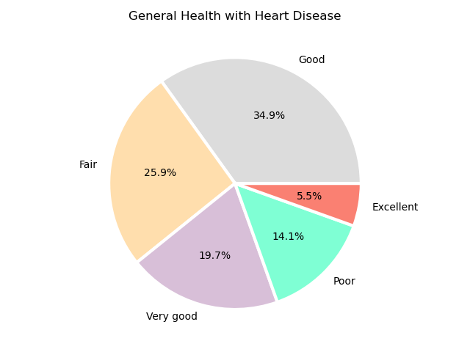
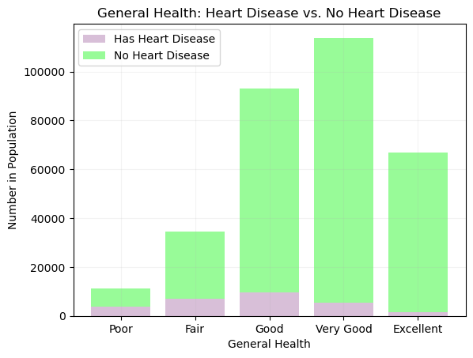
GENERAL OVERALL HEALTH W/ HEART DISEASE
Aaron
Over 60% of the individuals with heart disease also reported that their general health was ”Good” or better
“Good” was the most common response for general health for people with heart disease
”Very Good” was by far the most common general health answer for individuals without heart disease
“Would you say that in general your health is –?”

Slide 9
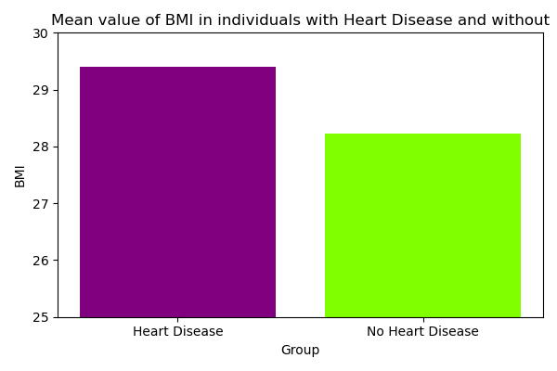

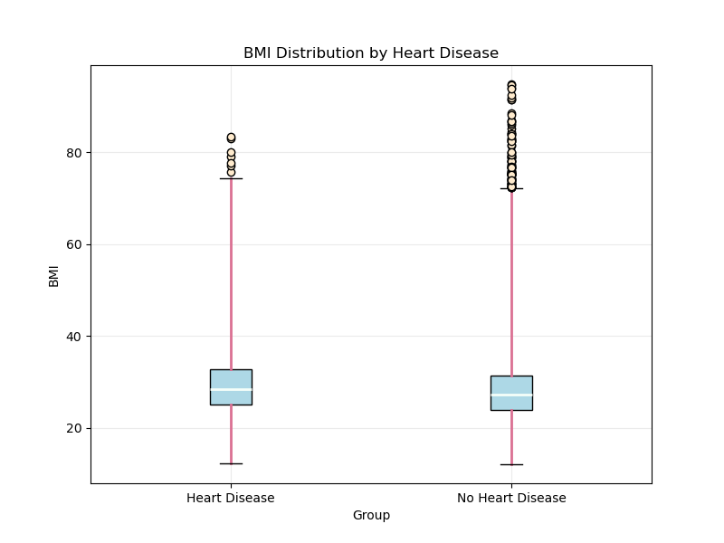
BMI
Jason
Body Mass Index (BMI) is the height to weight ratio used to calculate body fat
BMI has limitations based on age, physical fitness, and ethnicity
We predicted that the average BMI would be higher for people with heart disease than those without
Though the data supports our prediction, the difference between the two is closer than we thought it would be and is statistically weak
BMI by itself would not be the strongest indication of having or obtaining heart disease
Source: CDC

Slide 10

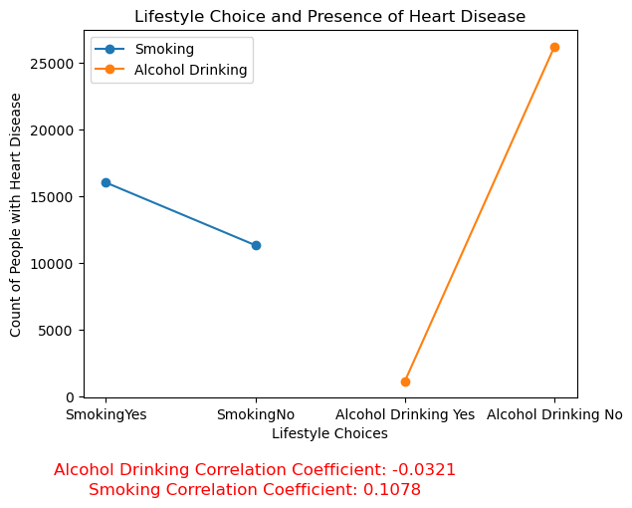
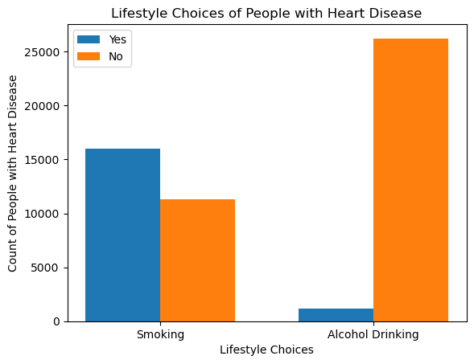
LIFESTYLE CHOICES
Jason
Heart disease is more prevalent among smokers than it is among alcohol drinkers
Of the 27,373 people with heart disease in our dataset, nearly 59% of them reported smoking less than 1% (1,141) of them reported drinking alcohol
Smoking had a weak, positive correlation with heart disease
Alcohol Drinking had a weak, negative correlation with heart disease
Our group predicted that smoking would be more common among those with heart disease than alcohol drinking

Slide 11
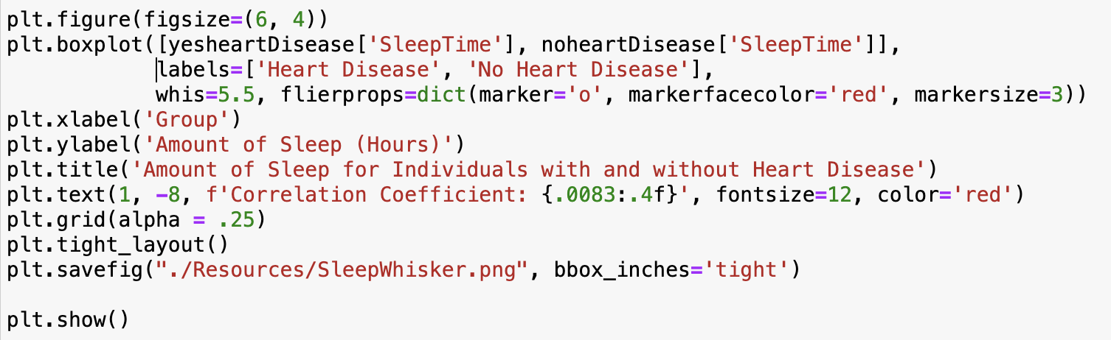
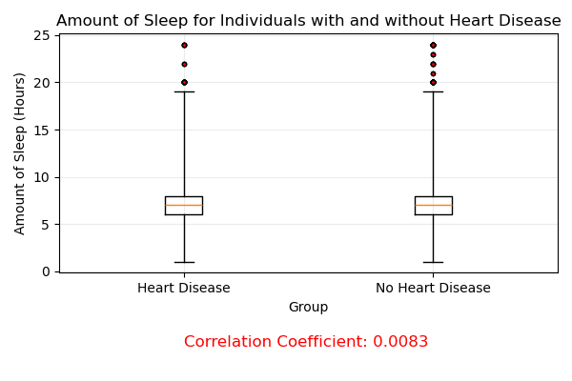
SLEEP
Nicoletta
We predicted that the fewer hours someone slept, the more likely a person would have heart disease
However, those with heart disease averaged slightly more hours of sleep per night than those without
The heart disease population averaged 7.14 hours of sleep per night
The population without heart disease averaged 7.09 of sleep per night
The correlation coefficient indicates that is nearly no correlation between amount of sleep and having heart disease

Slide 12
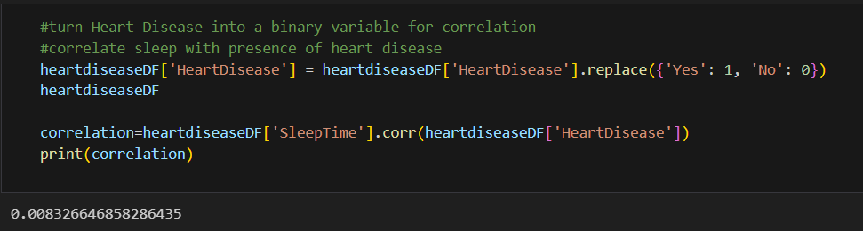
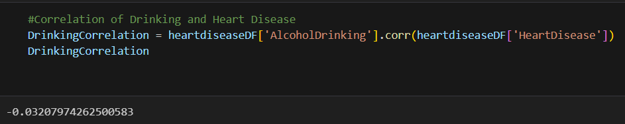
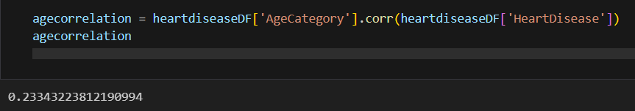
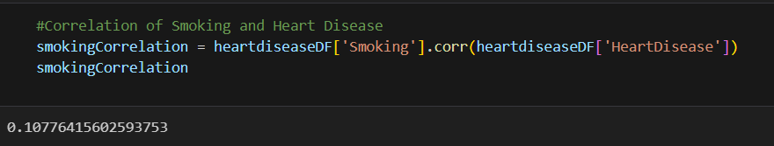
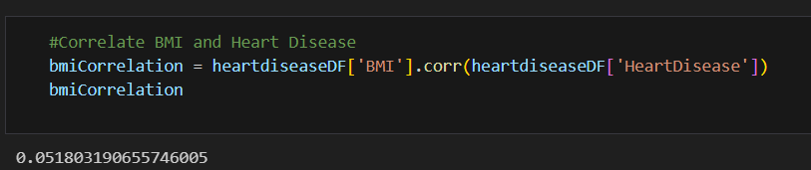
FINDINGS SUMMARY
Nicoletta
.008 correlation coefficient indicates little no correlation between having heart disease and the amount of a person gets
-.032 correlation coefficient indicates negative correlation between heart disease and alcoholic beverage consumption
.233 correlation coefficient indicates low correlation between heart disease and the amount of a person gets
.108 correlation coefficient indicates low correlation between heart disease and smoking
.052 correlation coefficient indicates very low correlation between heart disease and BMI

Slide 13
SOURCES
Kamil Pytlak. (n.d.). Personal Key Indicators of Heart Disease. Kaggle. https://www.kaggle.com/datasets/kamilpytlak/personal-key-indicators-of-heart-disease
Centers for Disease Control and Prevention. (n.d.). About heart disease. Retrieved from https://www.cdc.gov/heartdisease/about.htm
Centers for Disease Control and Prevention. (2020). BRFSS 2020 overview [PDF]. Retrieved from https://www.cdc.gov/brfss/annual_data/2020/pdf/overview-2020-508.pdf
Centers for Disease Control and Prevention. (n.d.). Calculate your BMI. Retrieved from https://www.cdc.gov/healthyweight/assessing/bmi/index.html#:~:text=Calculate%20Your%20BMI&text=Body%20Mass%20Index%20(BMI)%20is,or%20health%20of%20an%20individual.

